Slide 1
OPW Retail Fueling
Overfill Prevention Technology and Maintenance

Slide 2
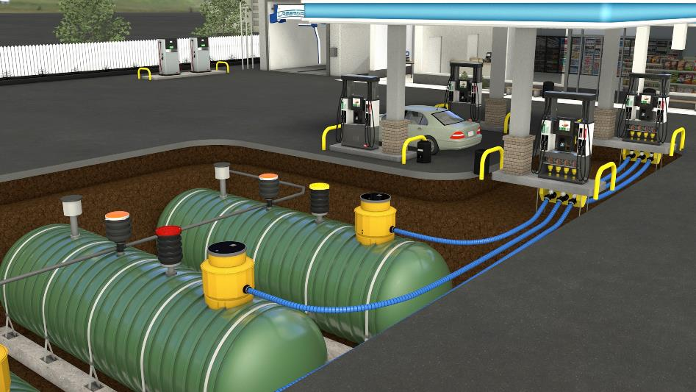






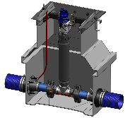
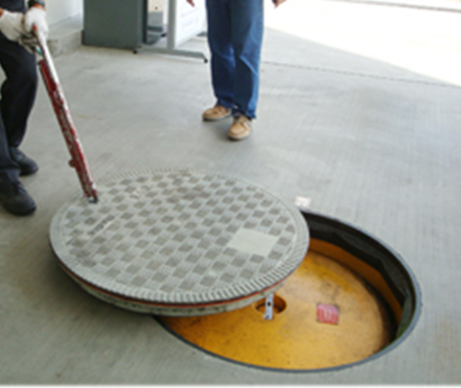
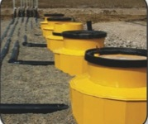
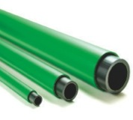
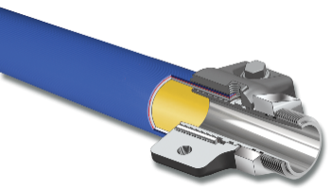
OPW Retail Fueling Overview
Above Ground Products
Dispensing
Above Ground Storage Tank Equipment
Stage II Vapor Recovery Equipment
CleanEnergy Fueling Products
Below Ground Products:
OPW Piping & Containment Systems
OPW Underground Storage Tank Equipment
KPS Petrol Pipe System™ Products
Fibrelite Watertight Composite Manhole Covers, Modular Trench Panels and Underground Enclosures

Slide 3
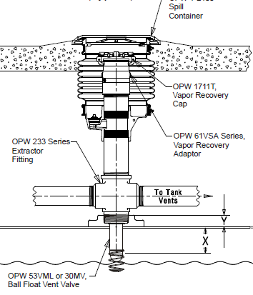
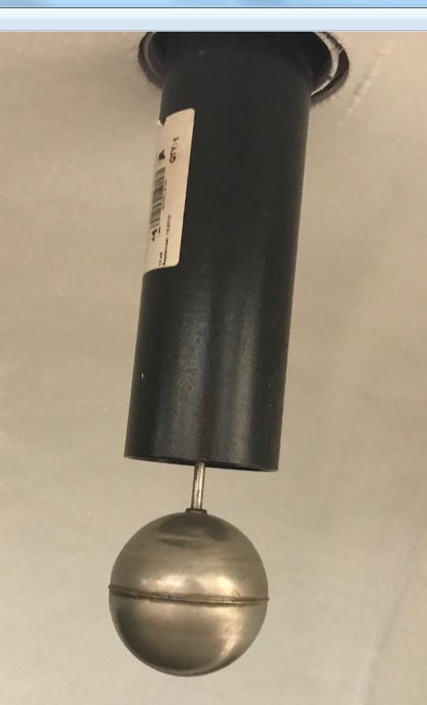
Ball Float Overview
Typical Installation
An overfill Indication device installed in the Phase 1 Vapor Recovery Extractor fitting
These are most often positioned to close at 90% of the tank capacity
Operates by restricting the pathway of vapor exiting the tank to the Phase 1 Vapory Recovery System during a tank fill.
Ball Float is lifted by the fuel level, thus increasing the pressure in the tank while dramatically decreasing flow of fuel from the delivery
The Delivery hose is effected by the reduction of flow and “kicks” between the fill elbow and the rack on the truck
The delivery driver must recognize the “kick” as an indication of the tank being full and shut off flow from the truck to avoid an overfill
Installation View From Inside the Tank

Slide 4
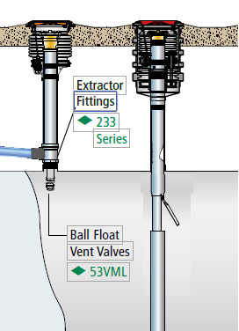
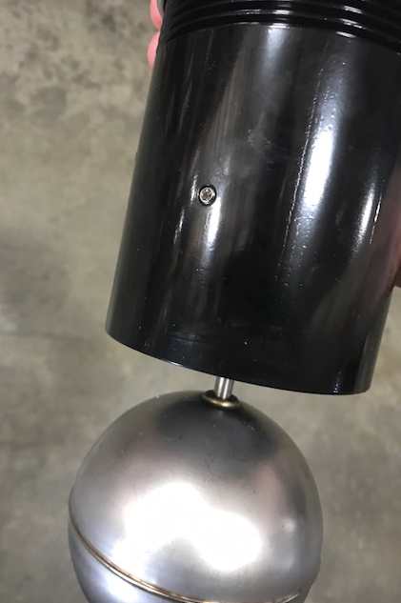
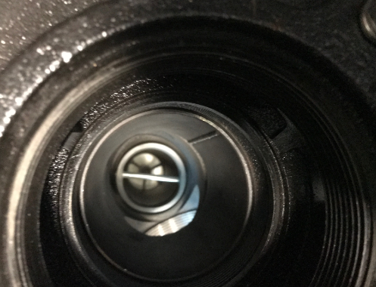
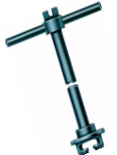
Ball Floats, Inspection and Maintenance
New Regulations do not allow Ball Floats as Primary Overfill Prevention Device, but some customers still utilize these as backup
If installed as a backup device, they must ensure that this is positioned with a shutoff point Above the overfill Prevention Device activation level
Bleed Orifice
Ball Float From Inside Spill Container
Extractor Wrench
Preventative Maintenance - Every three years, remove and inspect the valve for damage, contamination, corrosion, freedom of movement of the ball float, and check the bleeder orifice for proper airflow. Replace if damaged or corroded.

Slide 5
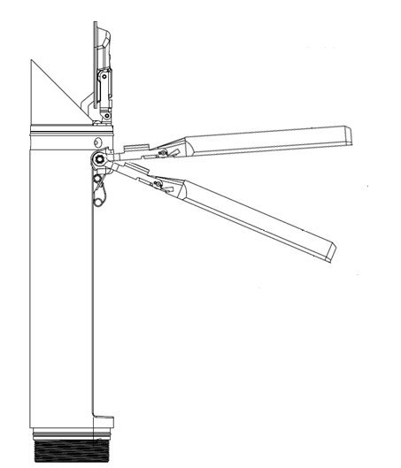
How a 71SO Overfill Prevention Device Works
Stage 2 – Automatic Overfill Prevention
Occurs only if fuel deliverer does not cut off flow from tank
Float arm continues to rise, closes secondary orifice
Flow is completely shut-off, preventing fuel from reaching tank top
Stage 1 – Overfill Detection
Float arm pushes valve flap beyond protective bend in upper tube
Main valve flap immediately sealed closed by fuel flow
Fuel deliverer is notified tank is nearing full by hose jump
Fuel reduced to 3-5 GPM through secondary orifice to empty hose

Slide 6

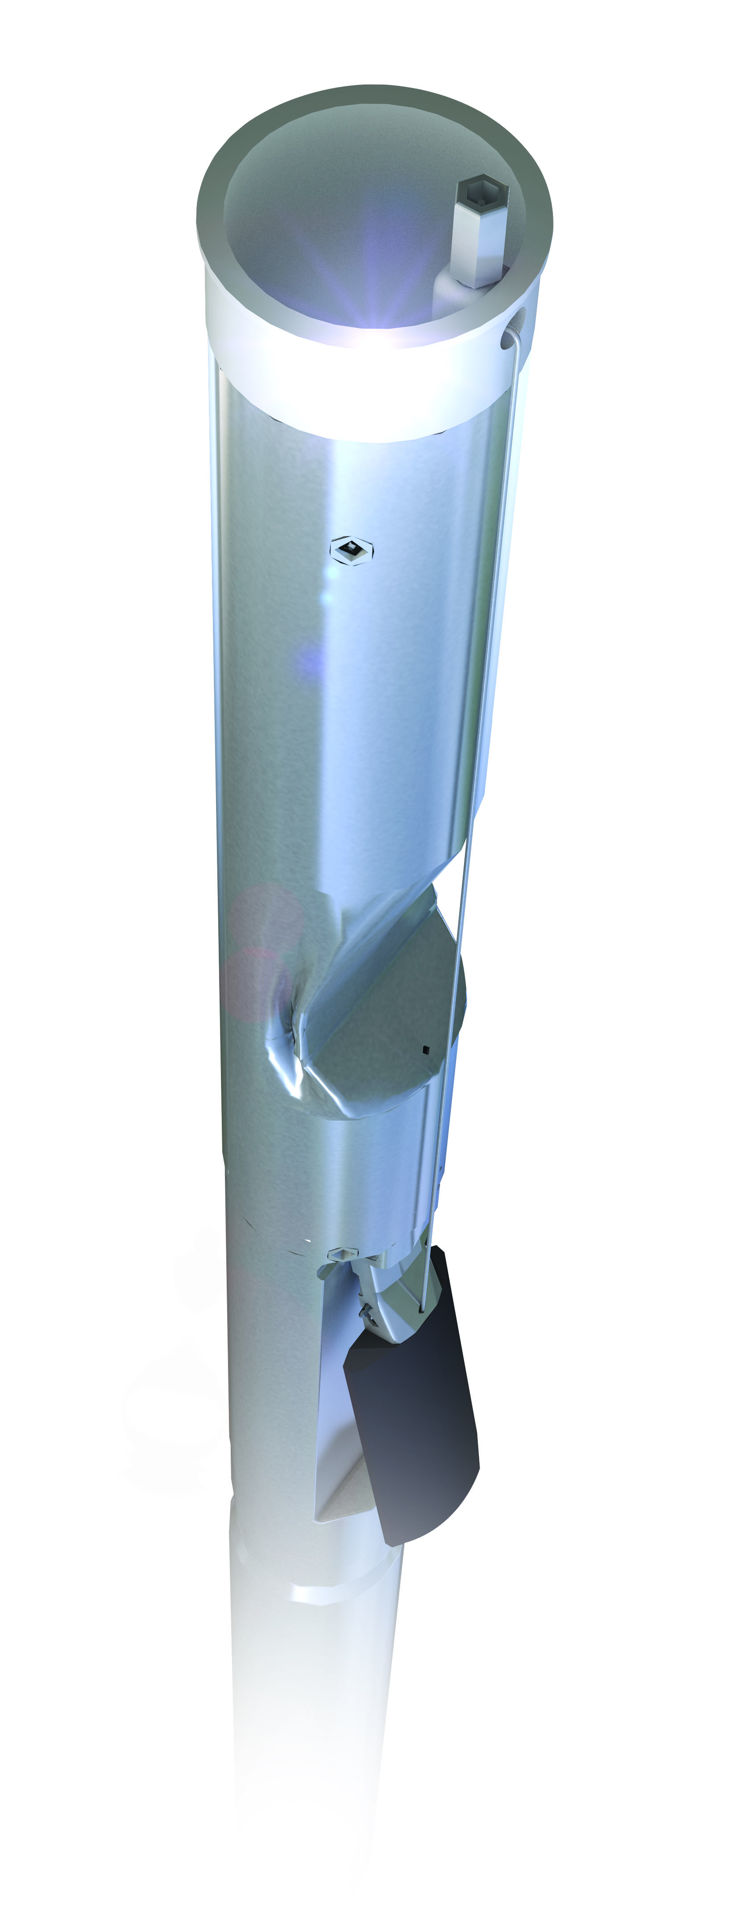

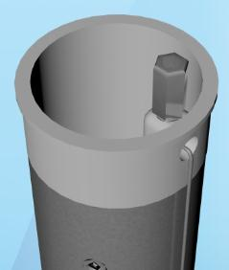
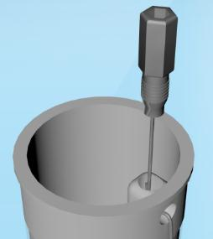
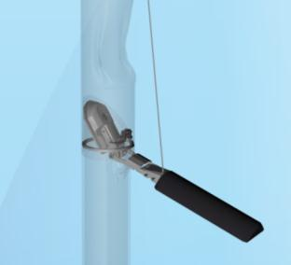
Next Generation Overfill Prevention Valve
New Product Launched in 2012
Allows Overflow Valve to be functionally tested without removing from the ground:
  Simple test avoids an hour of removal and reinstallation time for 2 contractors
  Eliminates opportunity to damage float mechanism and critical seals for vapor tightness
EVR Approved Testable Overfill Valve
Test in 60 seconds vs. 60 minutes per tank!
Lift Float with
Cable to Simulate Fill
Validate Proper
Poppet Operation
Loosen Test Plug

Slide 7
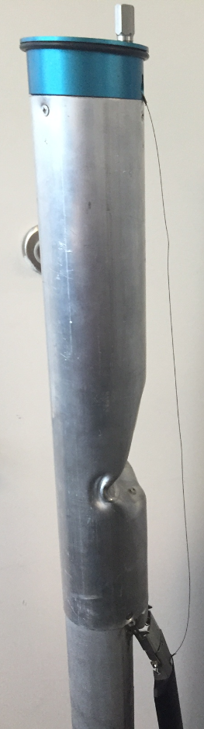
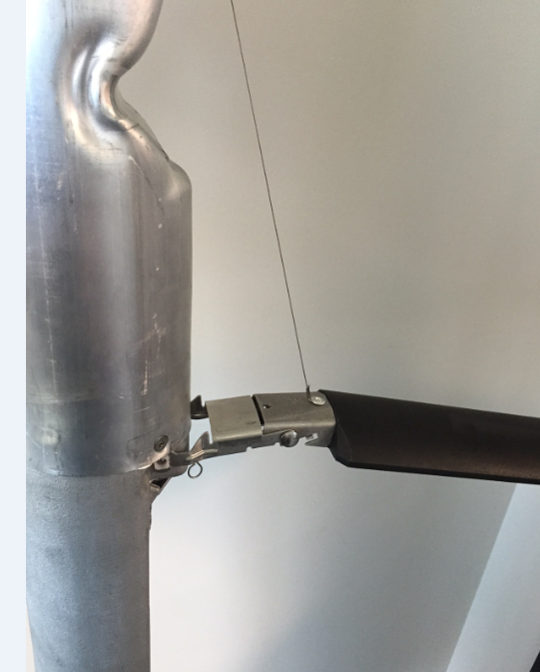
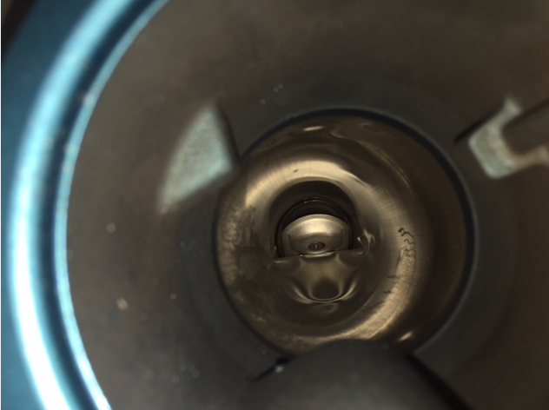
How 71SO Testable Functions
1
User snaps ¼” socket extension into test plug adaptor
Lifting the test plug adapter engages cable that is attached directly to bonded float bracket
Bonded float bracket engages valve poppet mechanism to close
User verifies valve function by visually seeing poppet close through inside of the tube while lifting test plug adaptor with socket extension
4
2
3

Slide 8
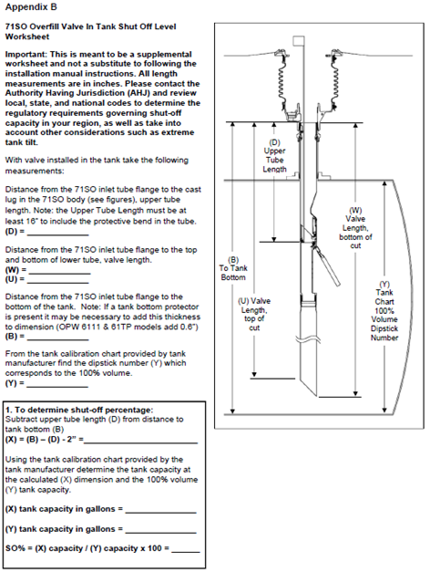
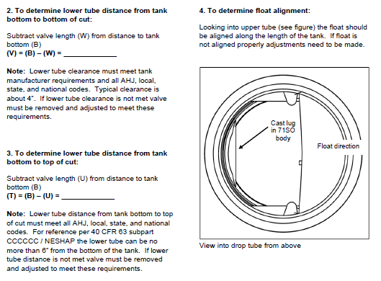
Measurement of Shutoff Point
OPW Provides Measurement Calculations and Instructions in our Installation Manual to determine the shut off position of the Overfill Valve without removal from the tank

Slide 9
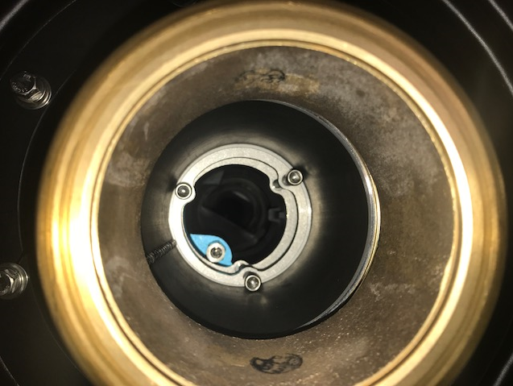
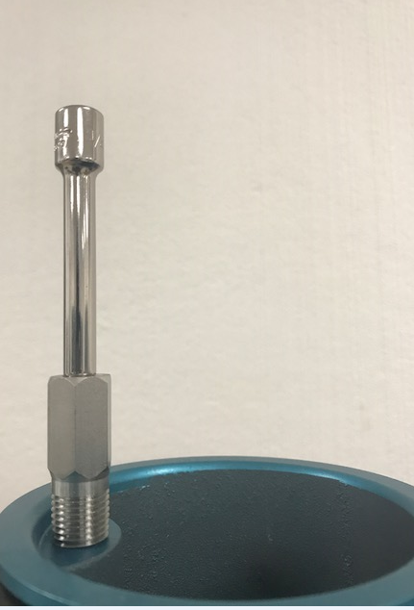
Frequently Asked Questions
Does the Test Plug interfere with the Jack Screw assembly?
  Answer: No, the test port is designed to fit between the lugs of the Jack Screws without any interference
Is a special tool required to perform the functional test?
  Answer: No, the 71SO Testable is designed to be easily tested by anyone with a ¼” socket extension
Will the test cable corrode in the aggressive environments within the tank risers?
  Answer: No, the 71SO Testable utilizes a 300 Series Stainless Steel Cable that does not corrode.

Slide 10
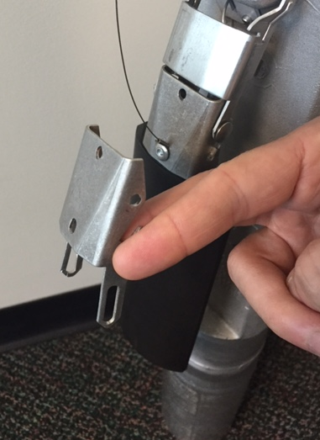
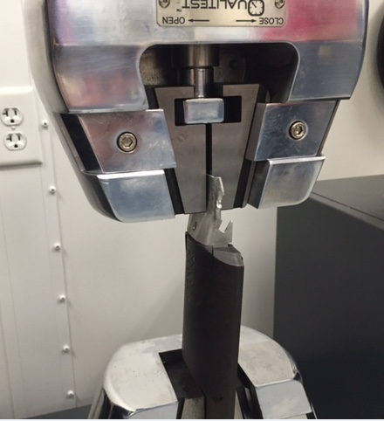
Frequently Asked Questions
Can the test cable break?
  Answer: No, the test cable is extremely strong (>70 lbs tensile strength).
Does the test cable pull on the float or the bracket?
  The float is molded over and through the bracket that the cable is attached to, so this is fused as a single piece. It takes several hundred pounds of force to separate the bracket from the float
What happens if the float arm bracket is detached from the overfill valve in the tank?
  Answer: If the float arm is not attached to the valve inside the tank, pulling on the test plug will lift the float, but not activate the valve. The validation test of viewing the valve not closing from inside of the tube will demonstrate that there is an issue with the valve that must be addressed

